Slide 1

2020-10-07 Virtual Dresden
Peter Murray-Rust
#openNoteBookScience
Open Science: From the crisis of science to science for times of crisis?
Shweata Hegde Ambreen Hamadani
#openVirus
Simon Worthington
#openClimateKnowledge

Slide 2
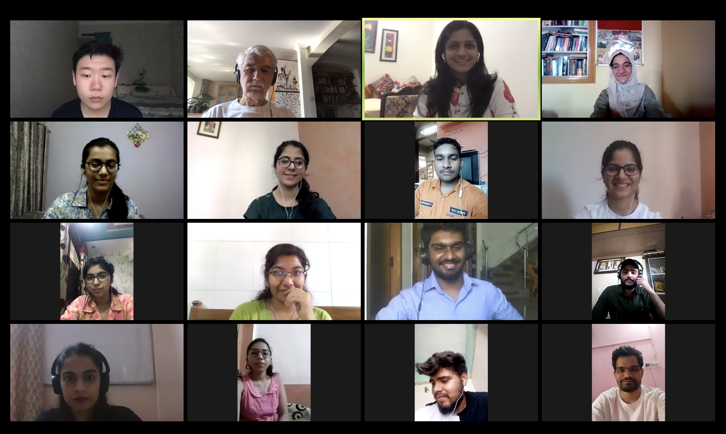
#openVirus Team

Slide 3
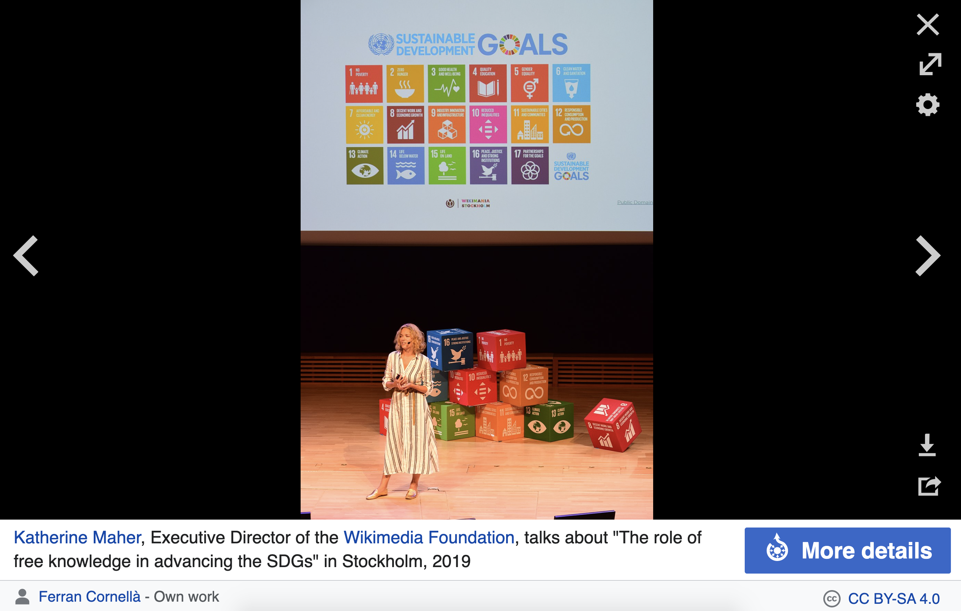


Global Crises
UN Sustainable Development Goals

Slide 4
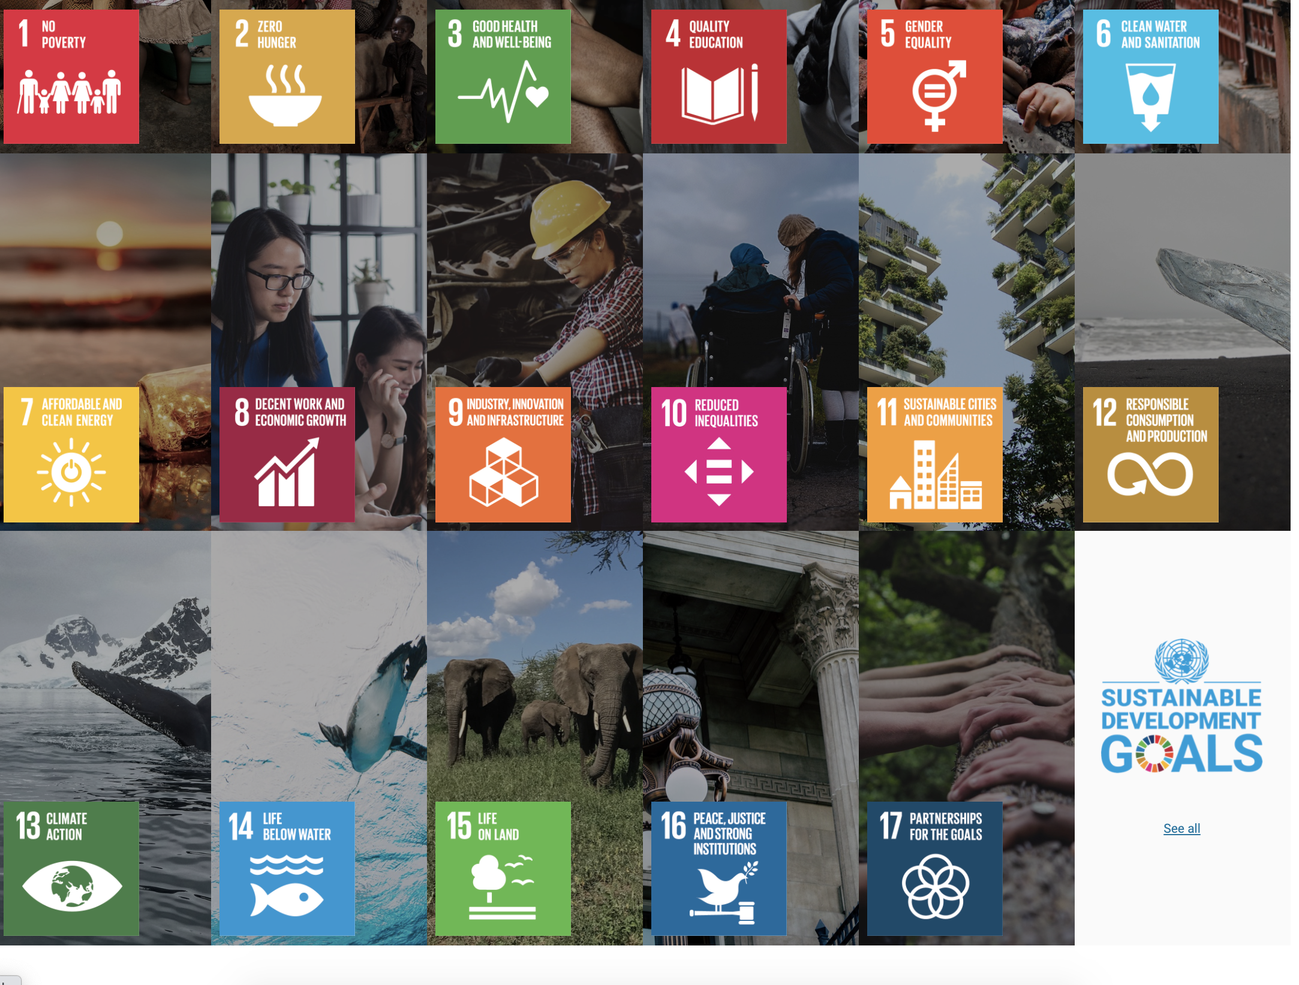
Global Crises: UN Sustainable Development Goals

Slide 6
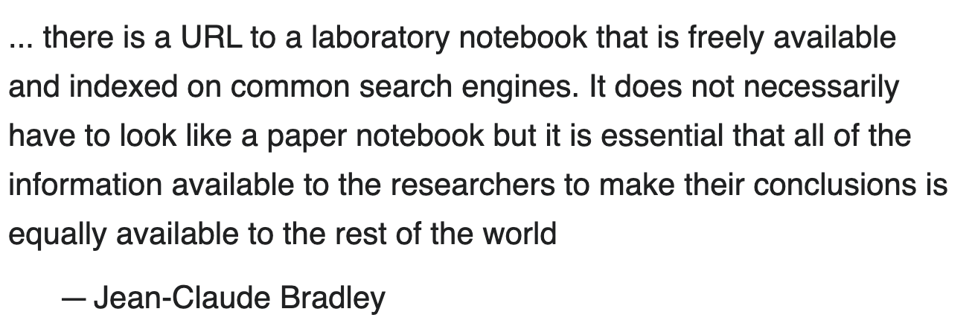
Open (Notebook) Science
Inclusive by
age, geography, education, race, gender, language…
Examples:
Human Genome Project
GalaxyZoo/Zooniverse
Open Source Drug Discovery (IN)
Mozilla and Wikipedia
Open Access and Open Source do not imply Open Science

Slide 7
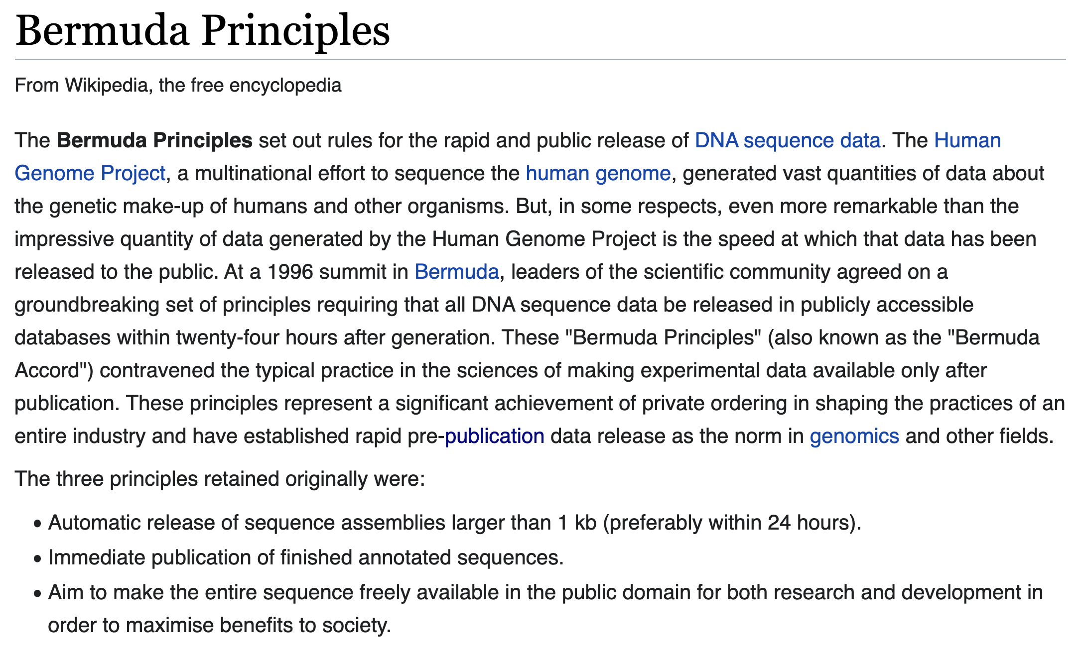
(Human Genome Project)
… all DNA sequence data [should] be released in publicly accessible databases within twenty-four hours after generation

Slide 8
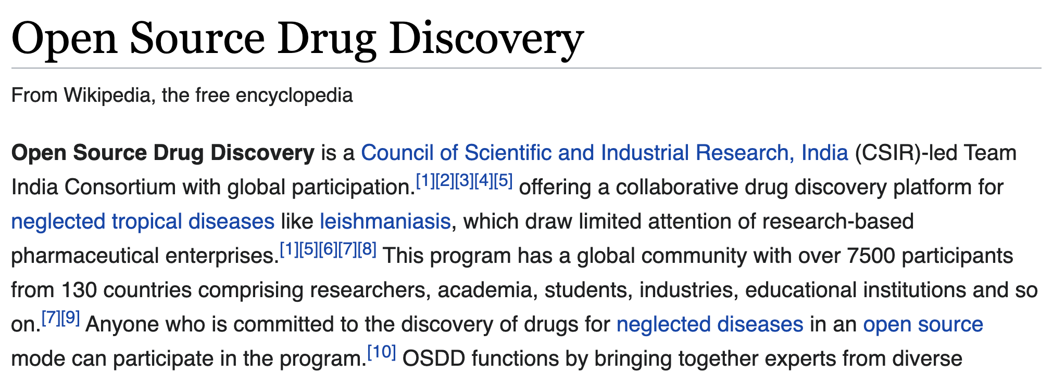

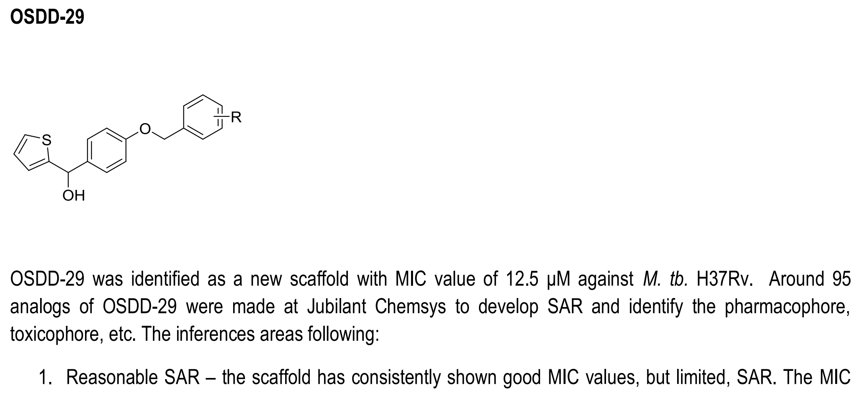
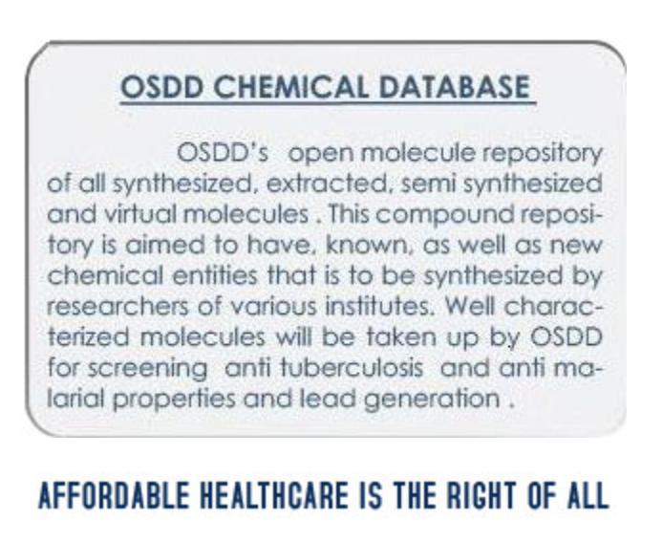


Slide 9
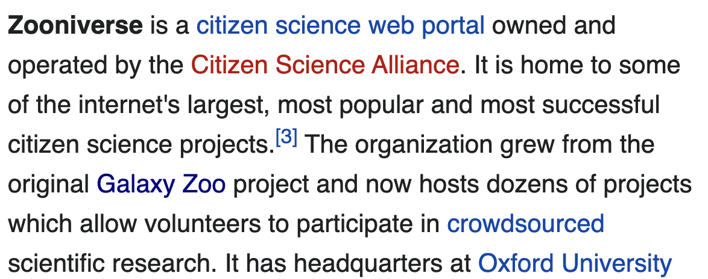
Classification
Annotation++ Decision Tree Filtering+ Transcription
Pattern Finding
including astronomy, ecology, cell biology, humanities, and climate science.^{[5]}

Slide 10
Open Knowledge for crises
What can citizens do?
Awareness : Climate
Crowds: Safecast;
OpenStreetMap
Aggregation: WikiProject COVID-19;
OpenKnowledgeMaps Covis
Community building
Literature Discovery: Ebola / Liberia prediction

Slide 11
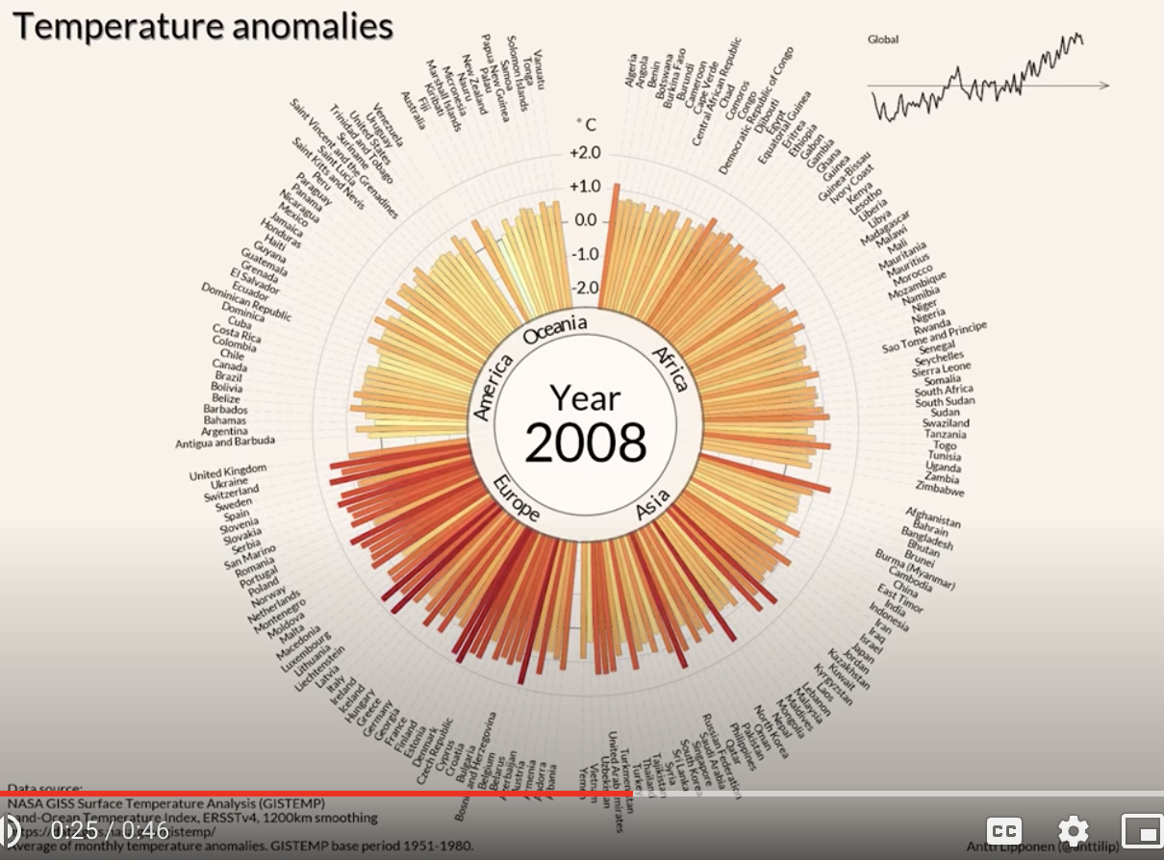
Awareness: Data that cannot be ignored
Antti Lipponen (@anttilip) of the Finnish Meteorological Institute based on GISTEMP data (CC BY 2.0).
https://twitter.com/dwallacewells/status/1312121745927598080/photo/1
Click this and
be very afraid =>
https://www.youtube.com/watch?v=-yIHxOui9nQ&ab_channel=CarbonBrief

Slide 12
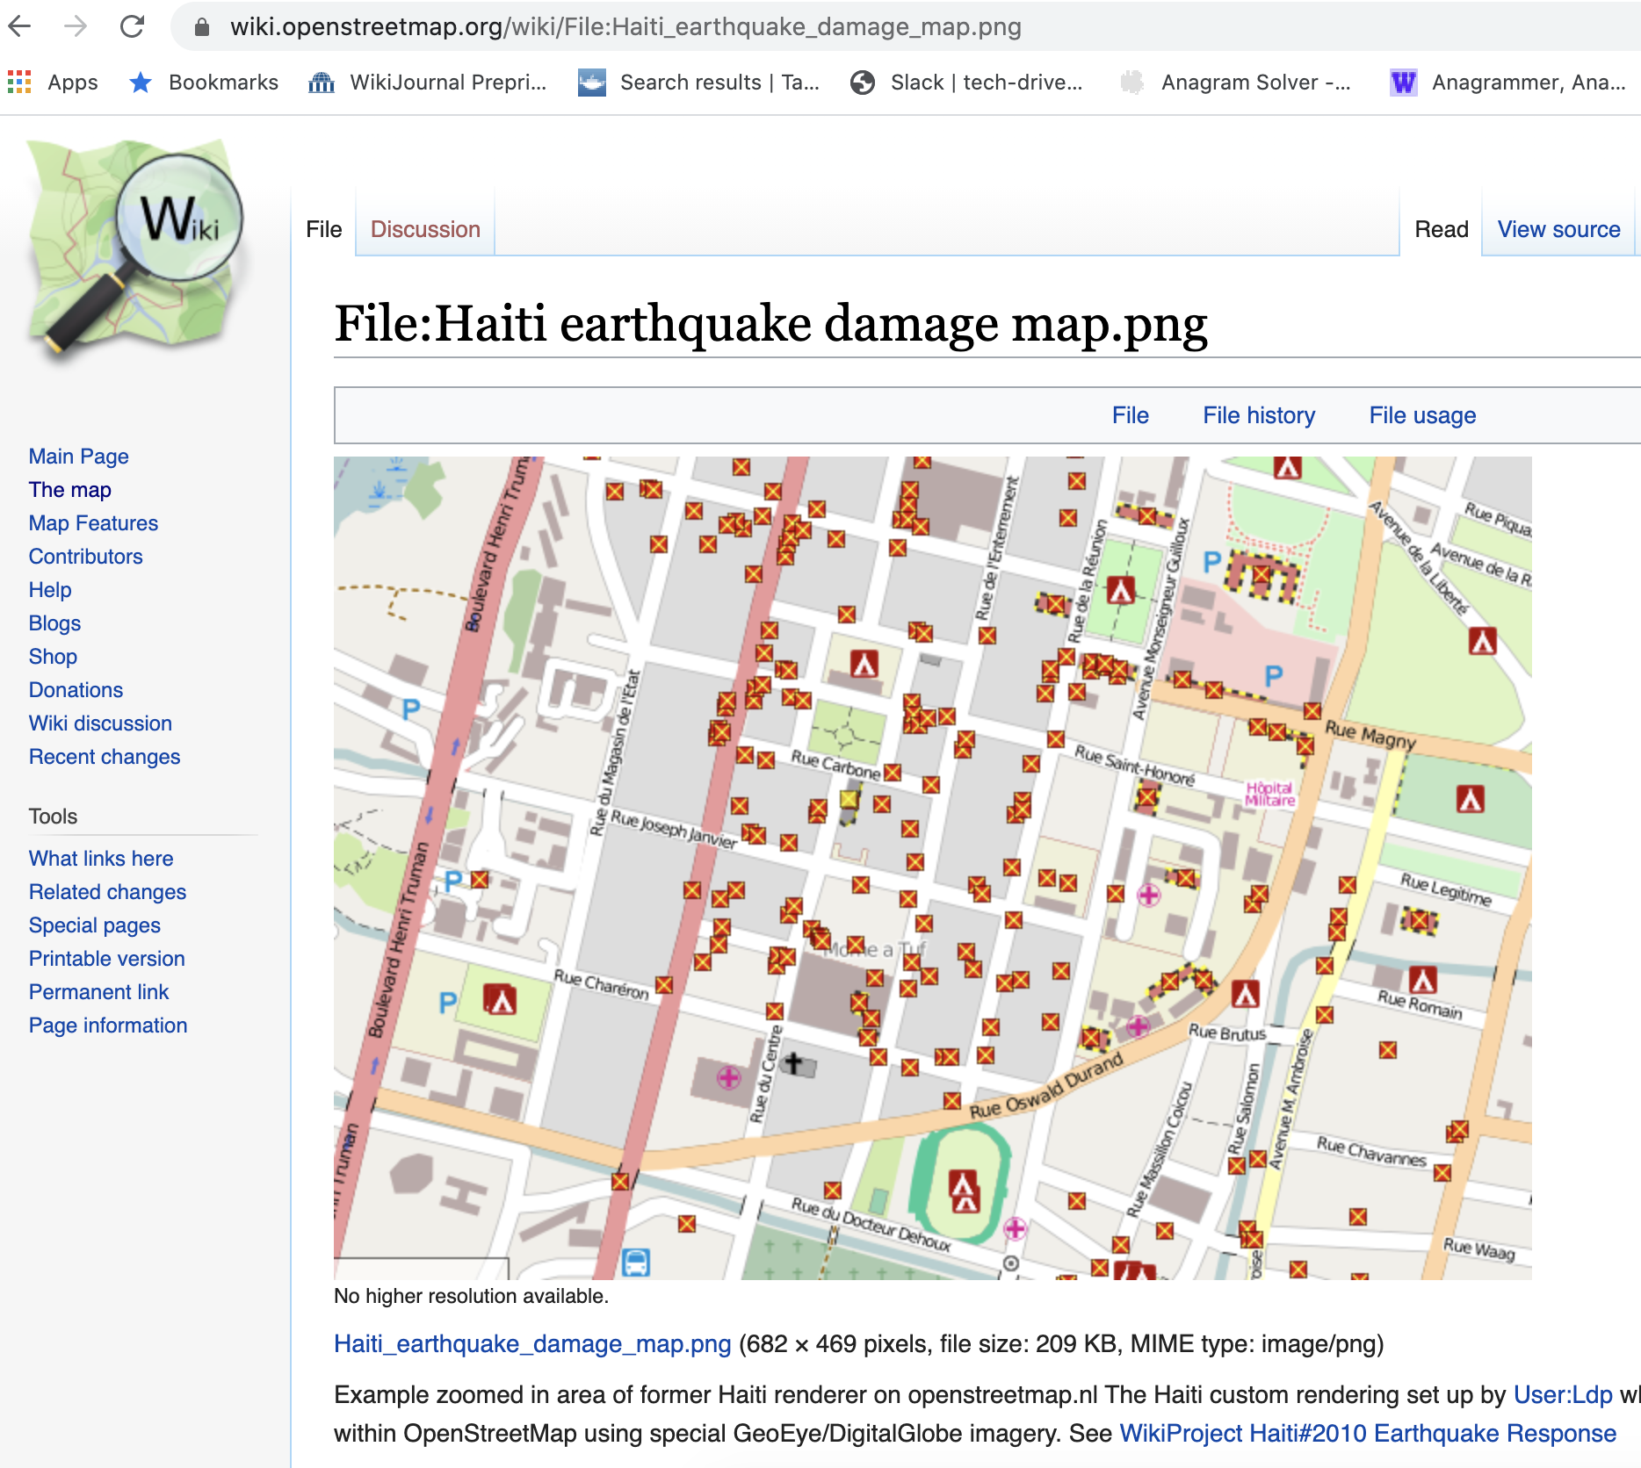
Haiti earthquake, OpenStreetMapping

Slide 13
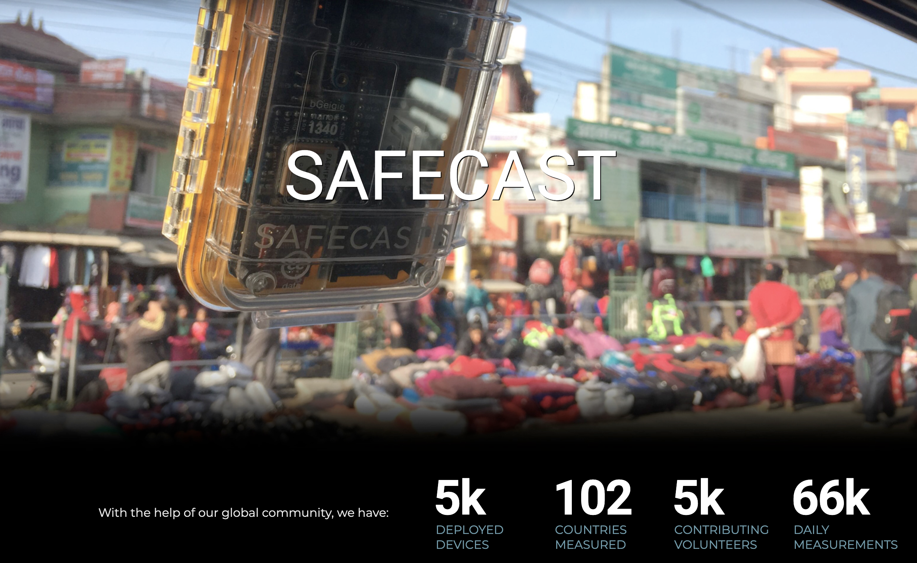
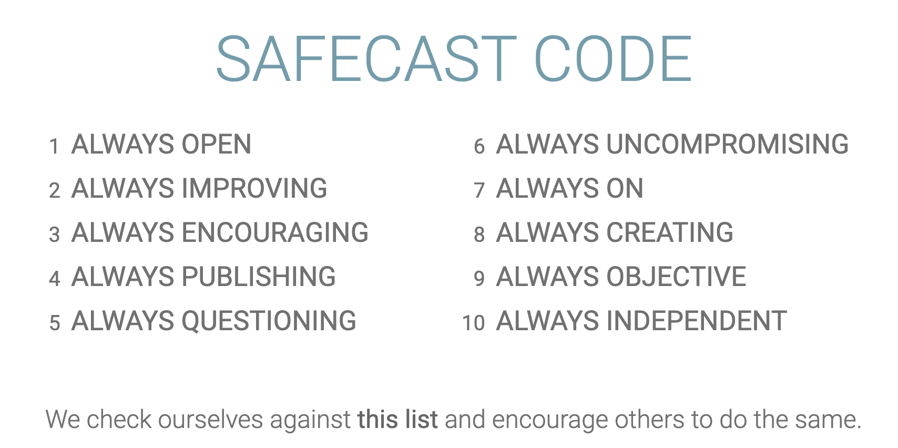
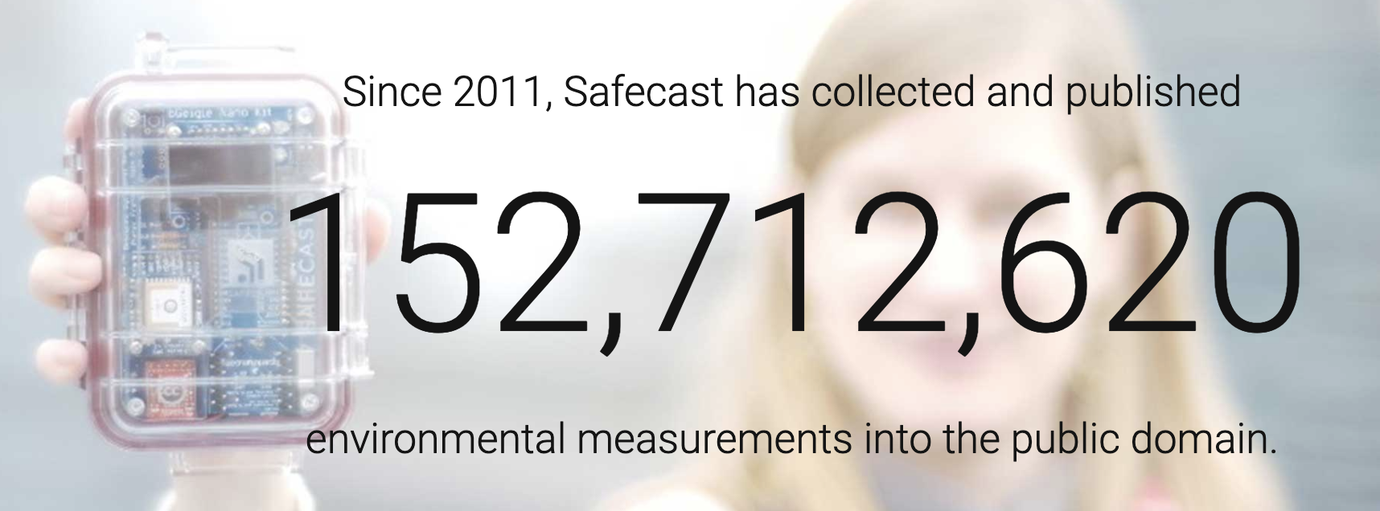
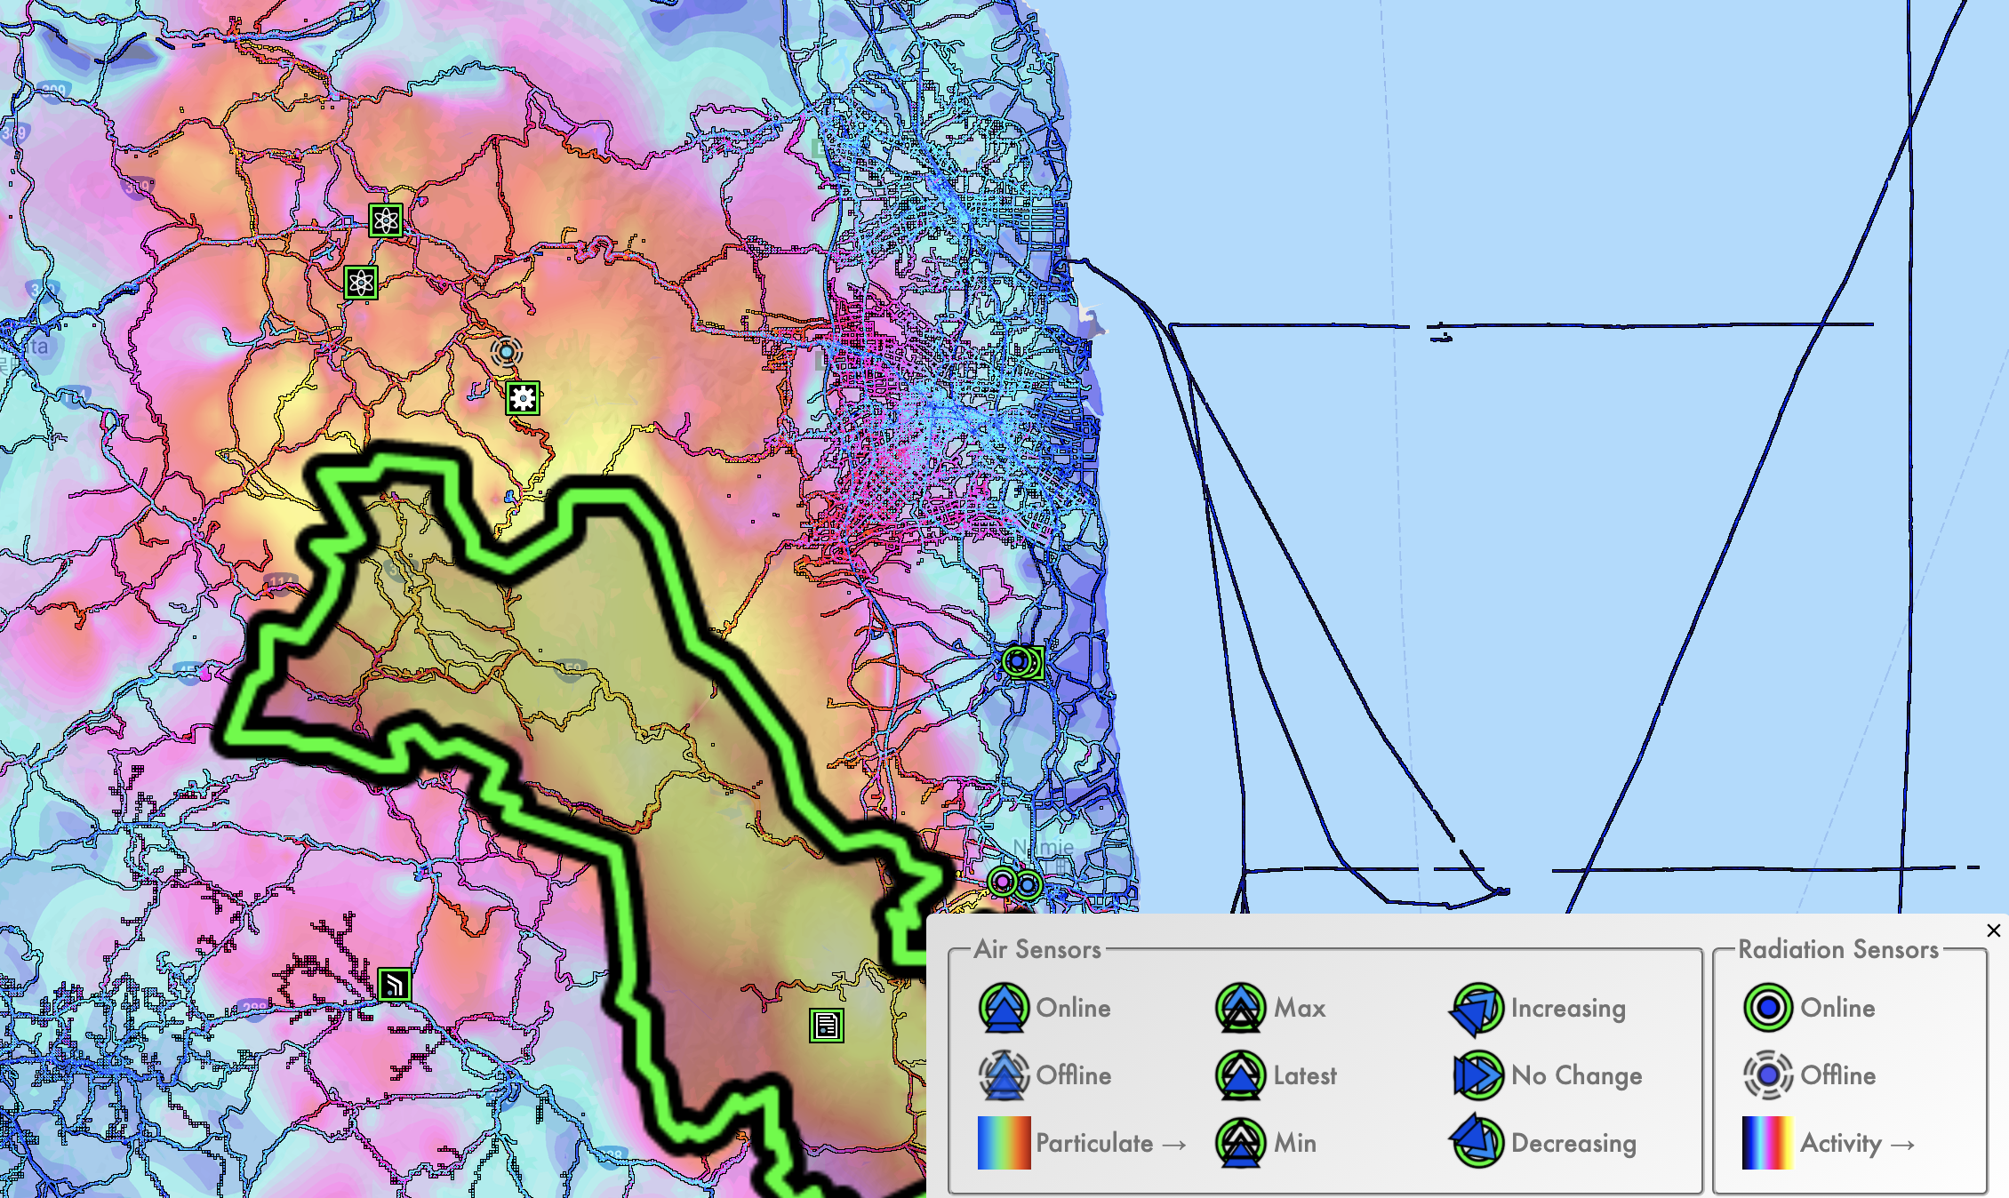
Fukushima
Every data point collected by a volunteer

Slide 14
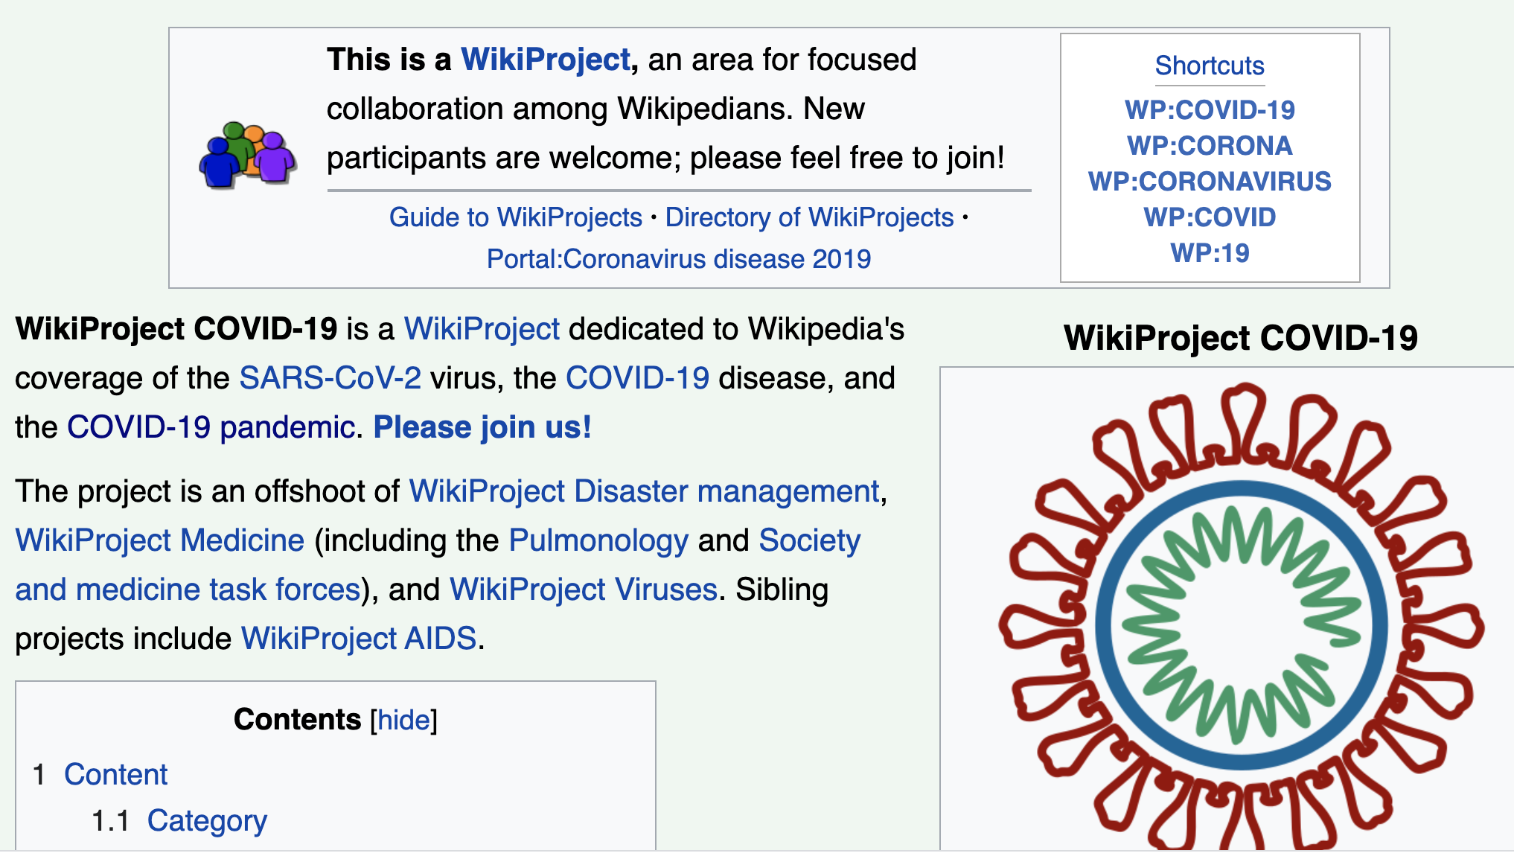
WikiProject COVID-19

Slide 15
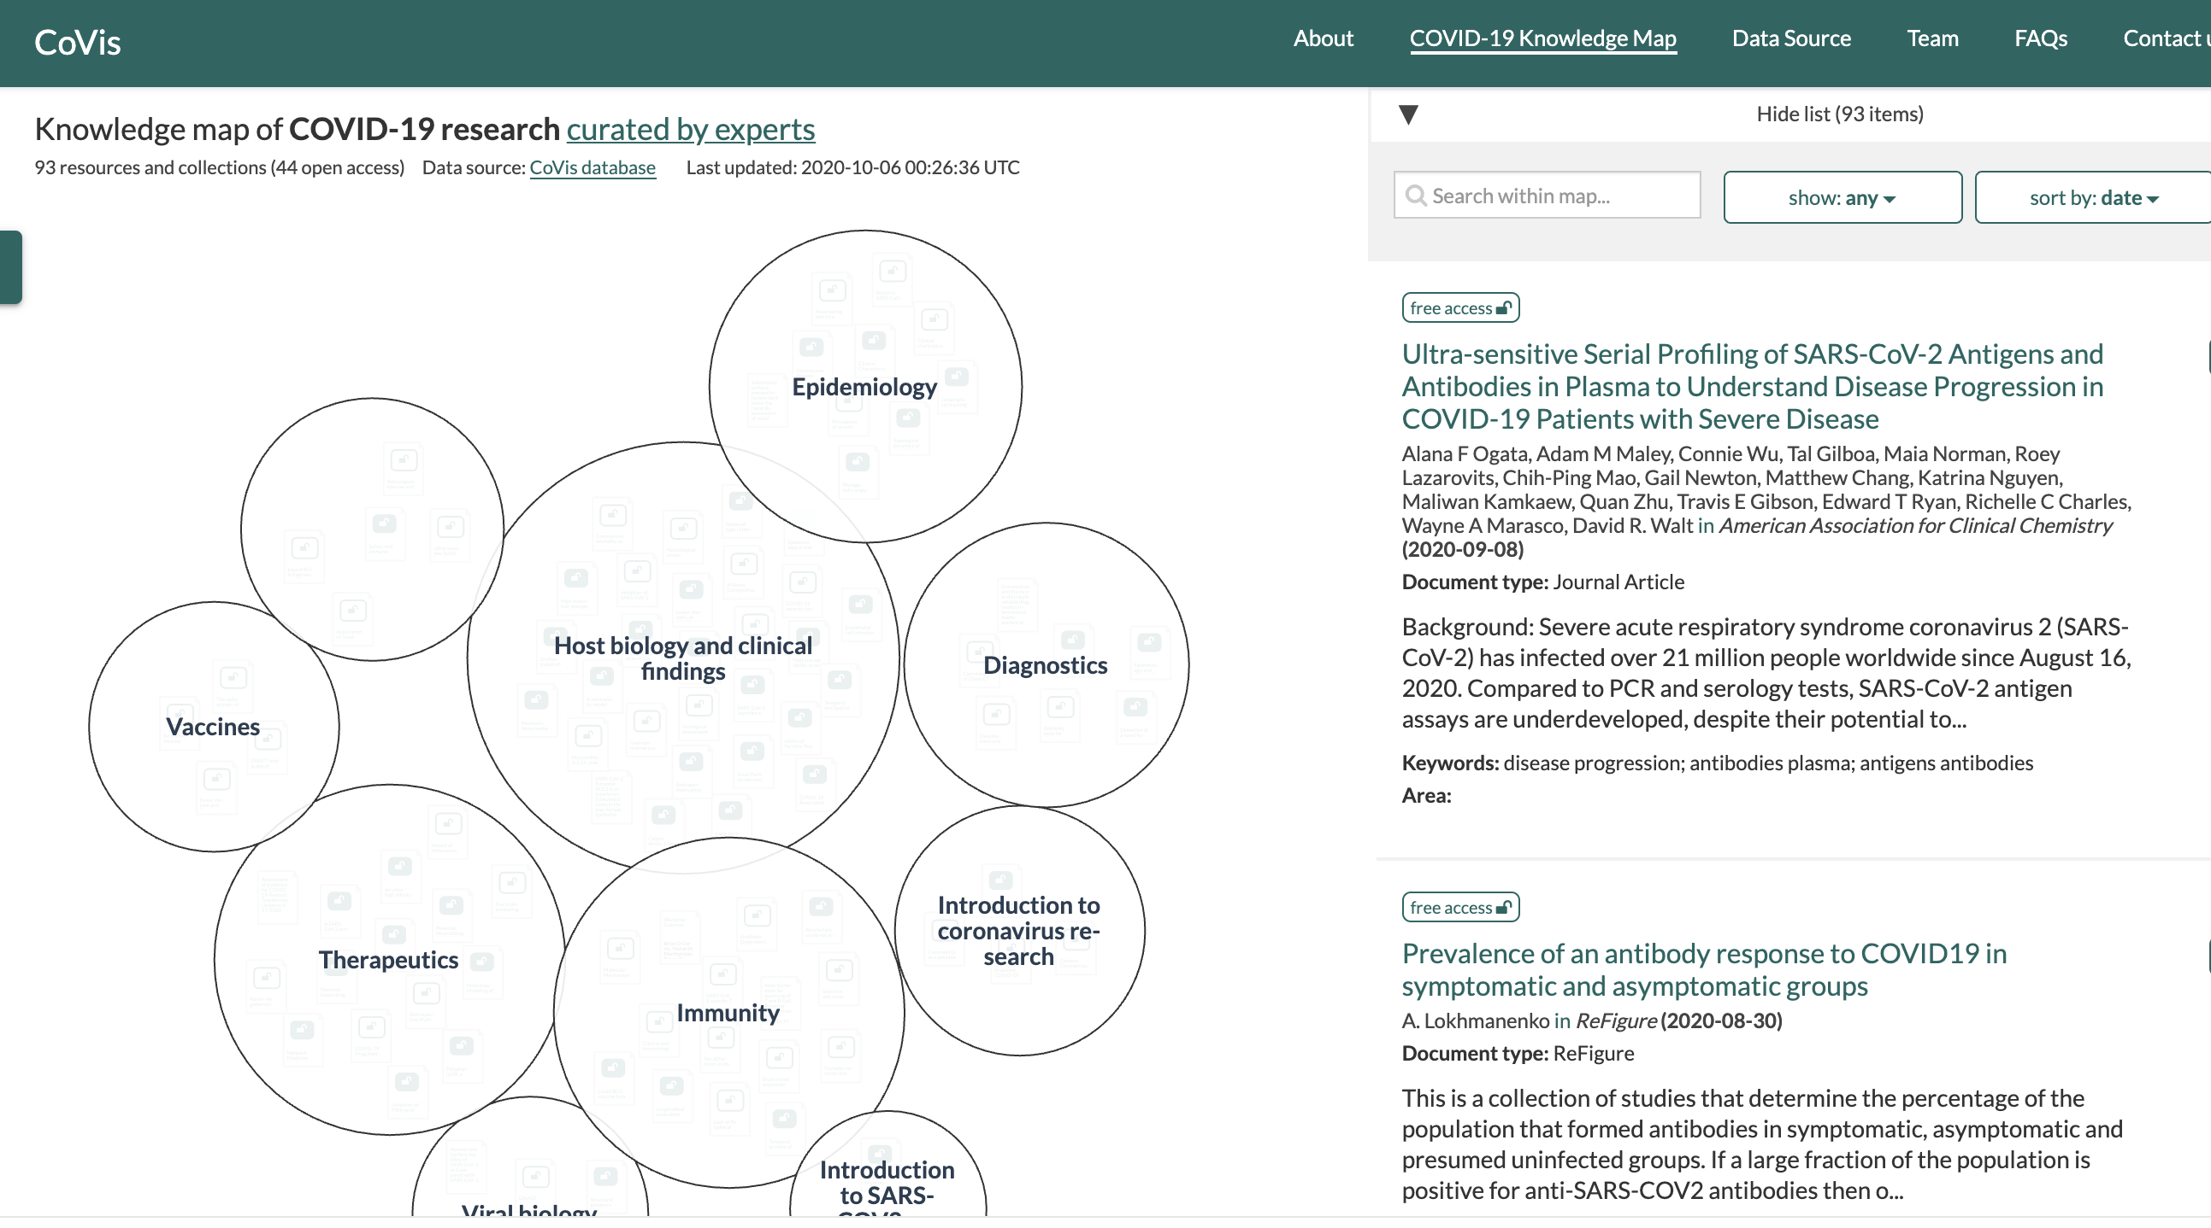
Open Knowledge Maps
https://openknowledgemaps.org/covis/knowledge-map

Slide 16
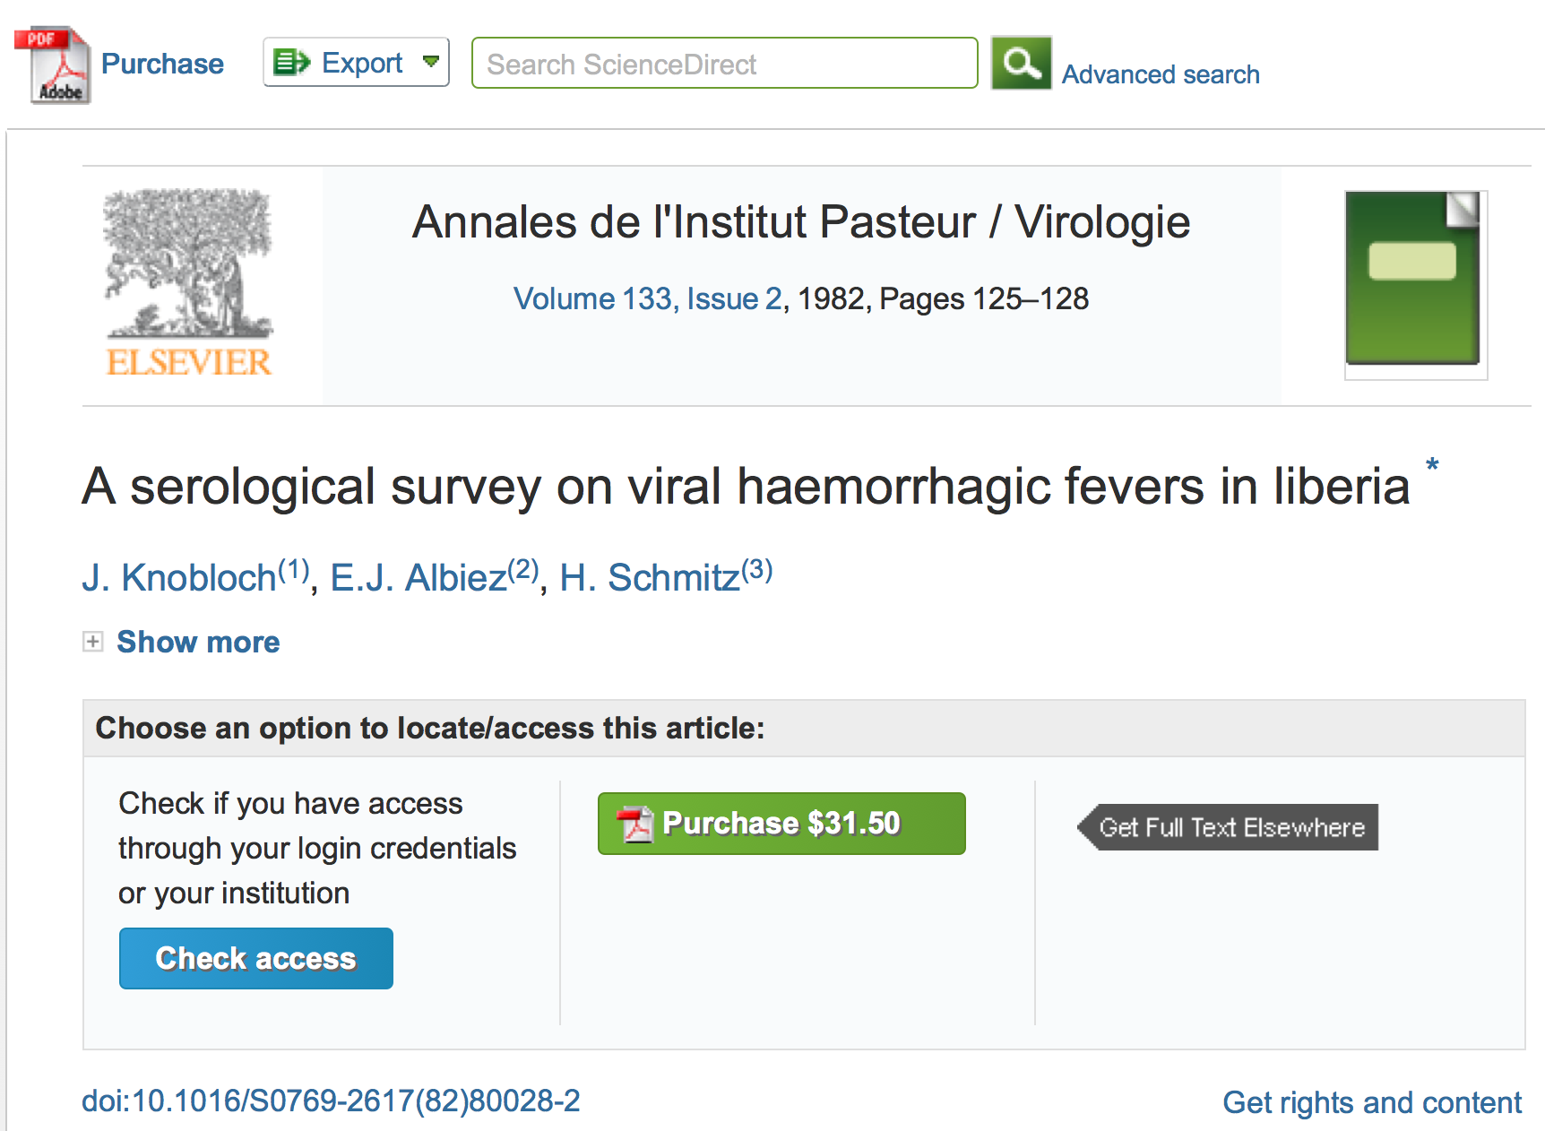
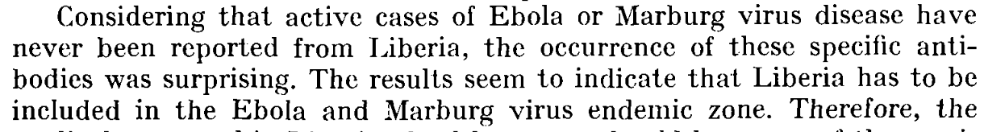

Slide 17
#openVirus
Can we predict the next epidemic or find useful past practices?
Make all open knowledge on all Viral Epidemics:
Universally available and accessible
Fully semantic and computable (“AI”)
… NOW
Shweata Hegde and Ambreen Hamadani will now show how it can be done…

